Slide 1
600 Jean-Talon
Floor plans

Slide 2
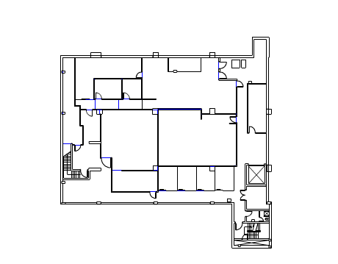
Basement 2

Slide 3
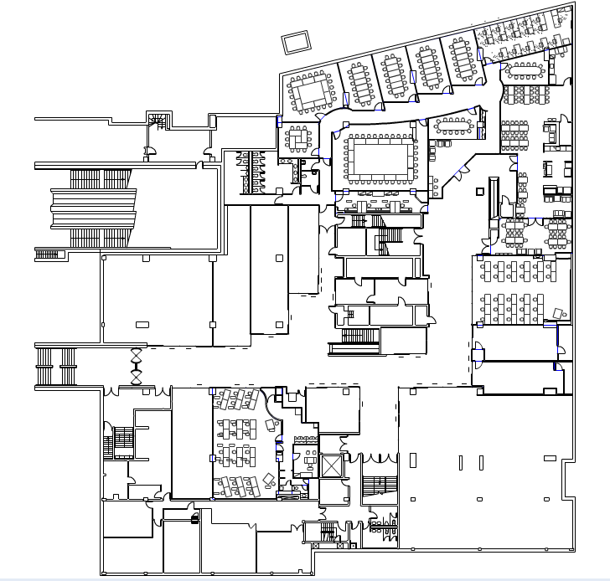
Basement 1 – metro level

Slide 4
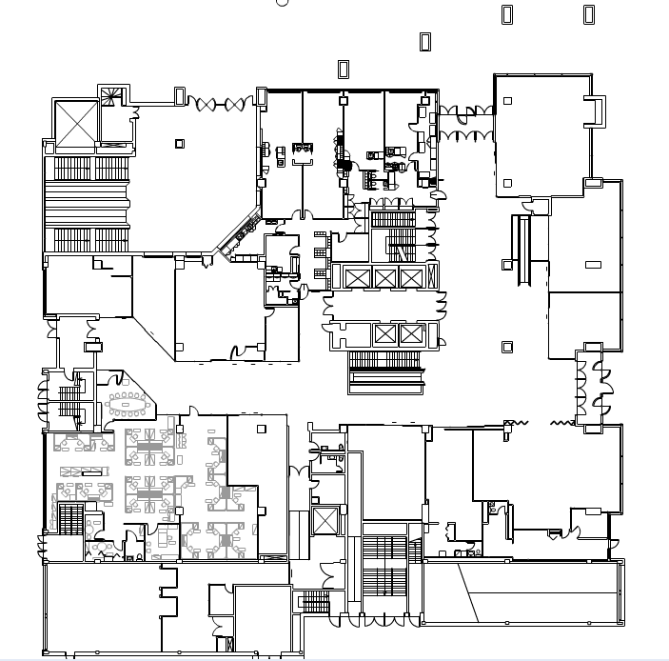
Ground floor

Slide 5
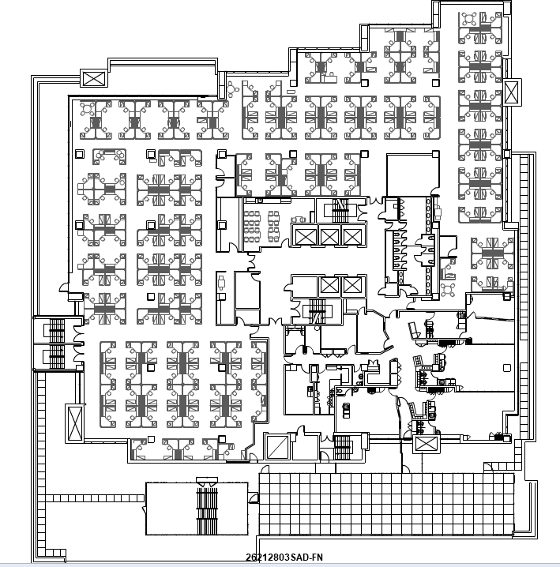
Floor 3

Slide 6
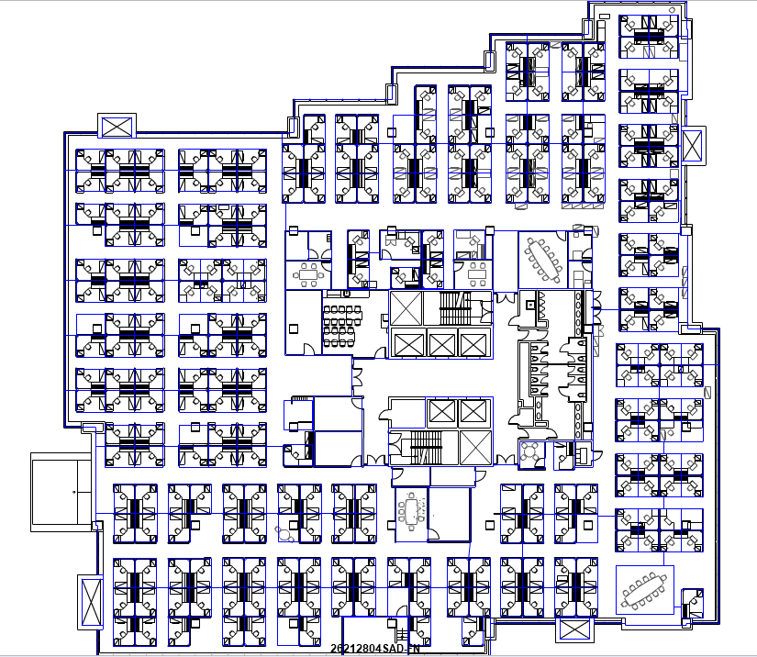
Floor 4

Slide 7
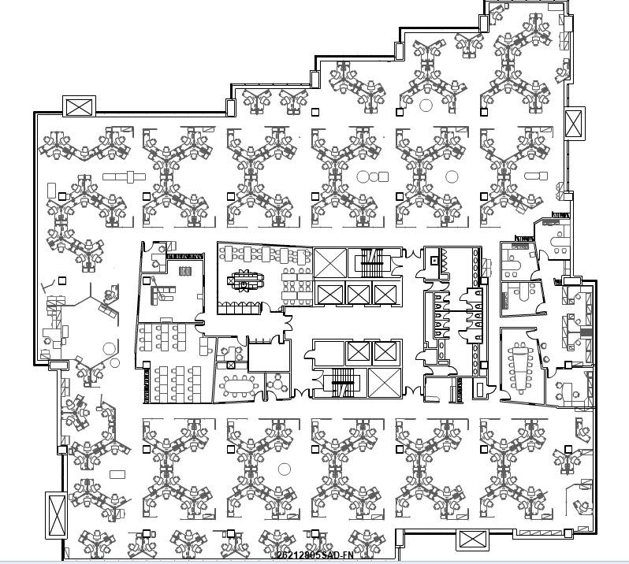
Floor 5

Slide 8
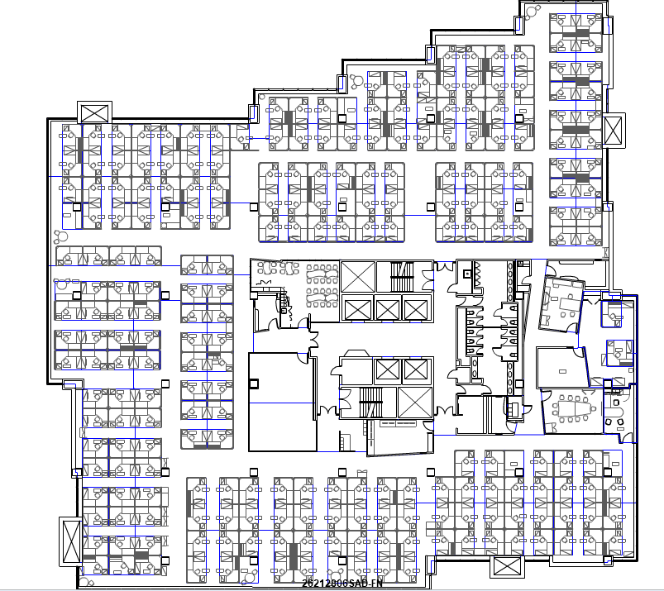
Floor 6

Slide 9
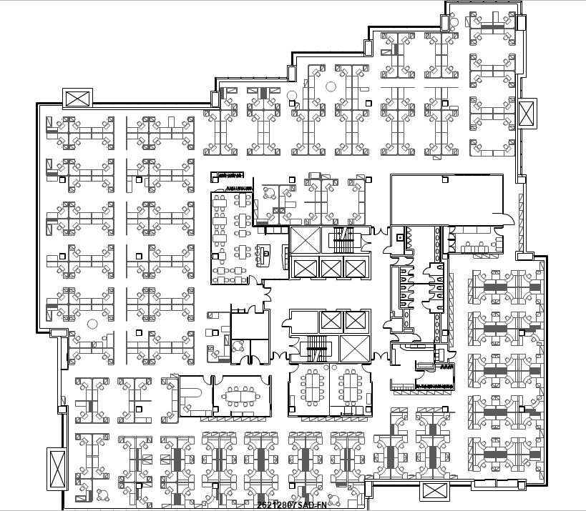
Floor 7

Slide 10
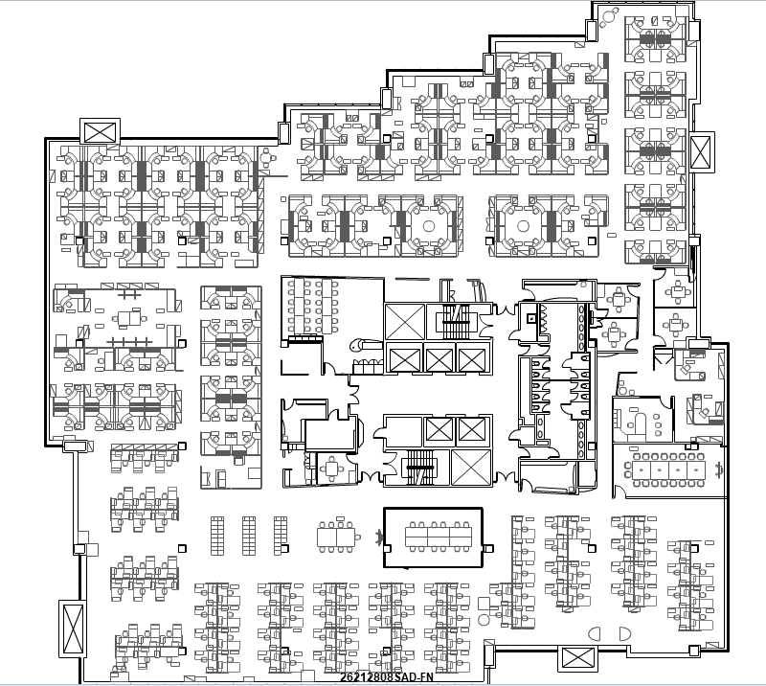
Floor 8

Slide 11
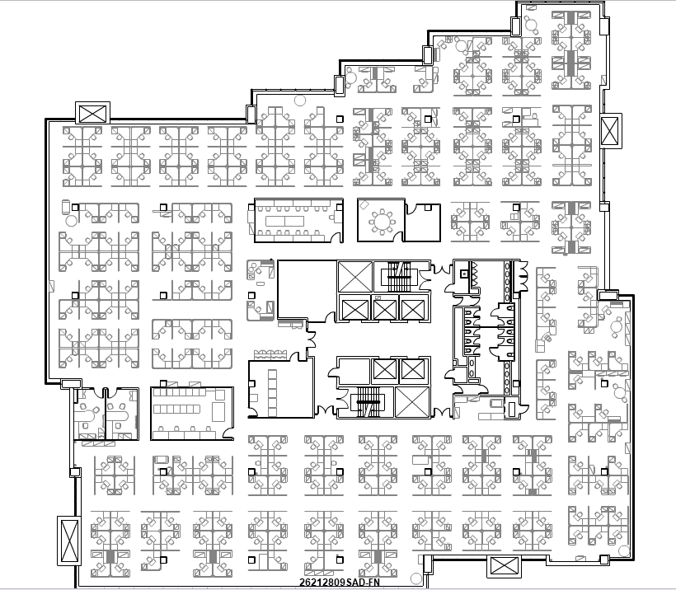
Floor 9

Slide 12
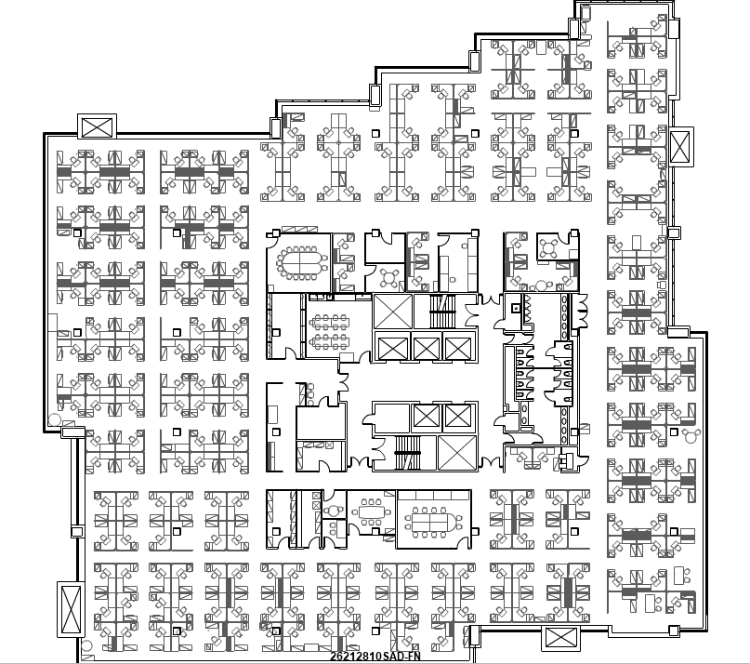
Floor 10

Slide 13
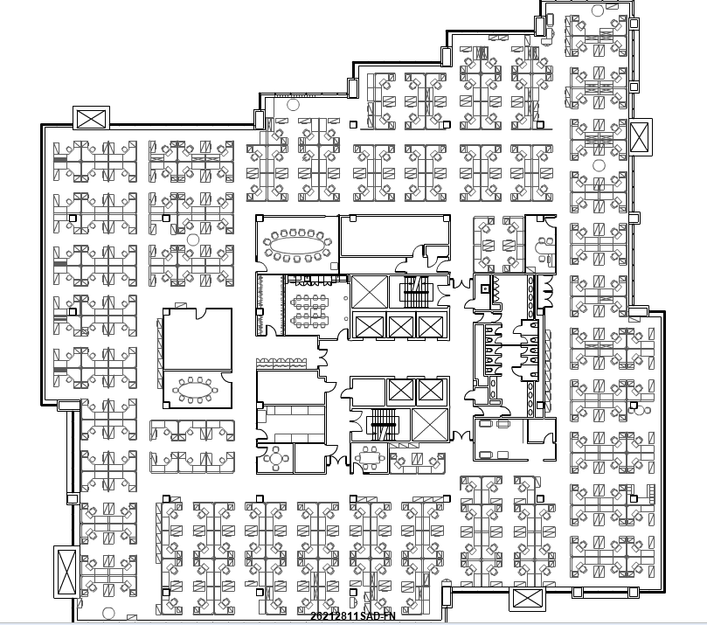
Floor 11

Slide 14
Nuns’ Island
Floor plans

Slide 15
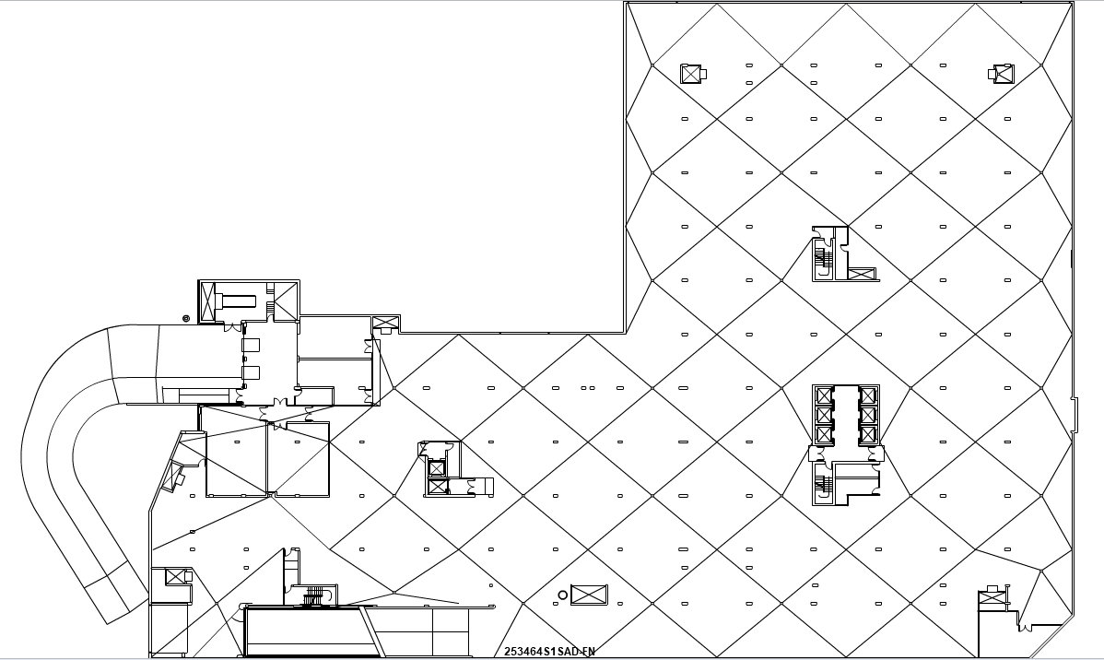
Phase 2 Basement

Slide 16
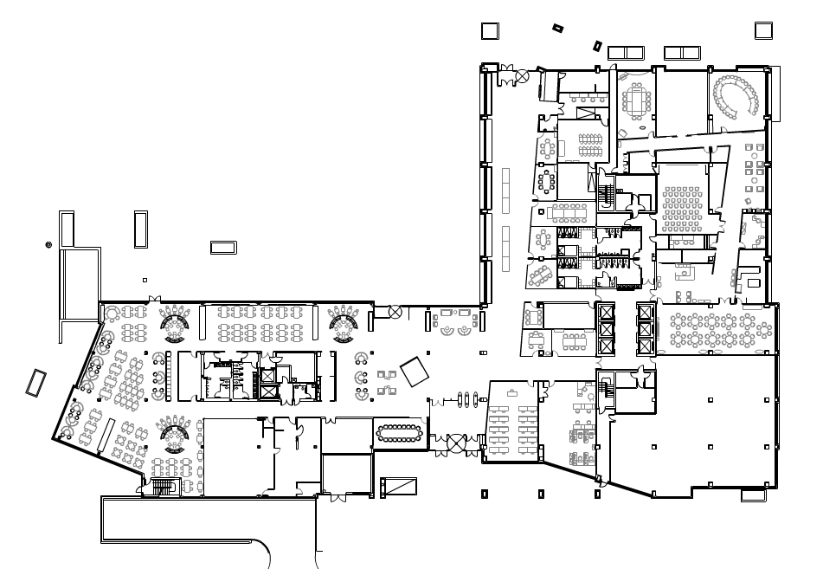
Phase 2 Ground floor

Slide 17
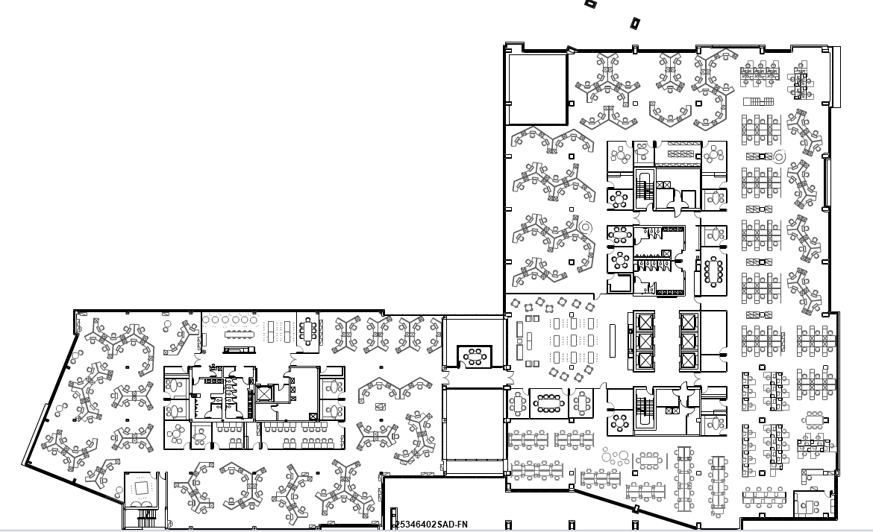
Phase 2 - Floor 2

Slide 18
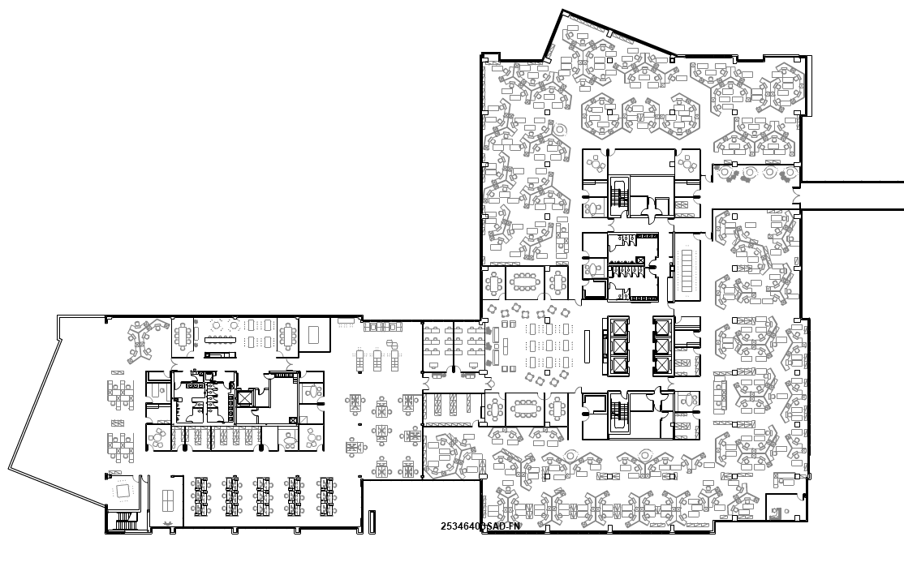
Phase 2 - Floor 3

Slide 19
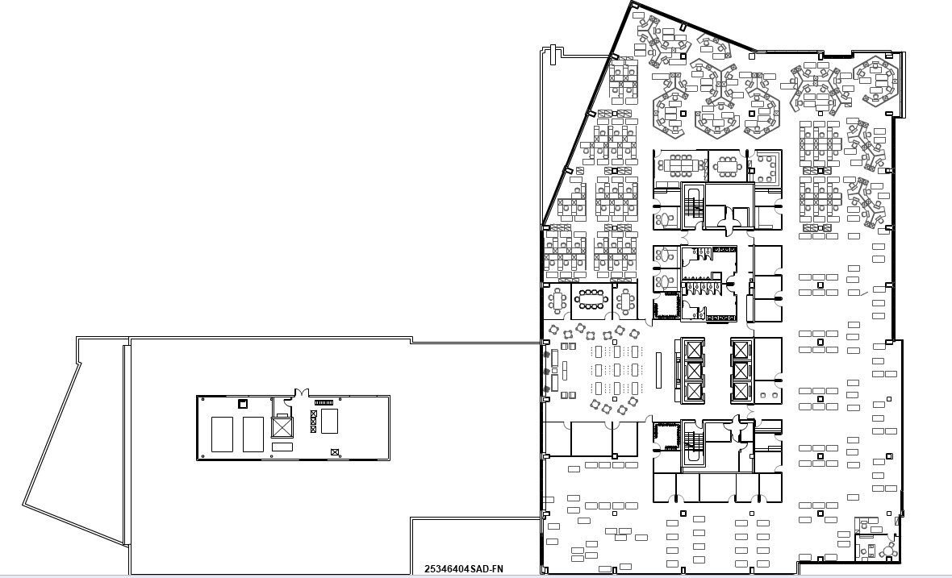
Phase 2 - Floor 4

Slide 20
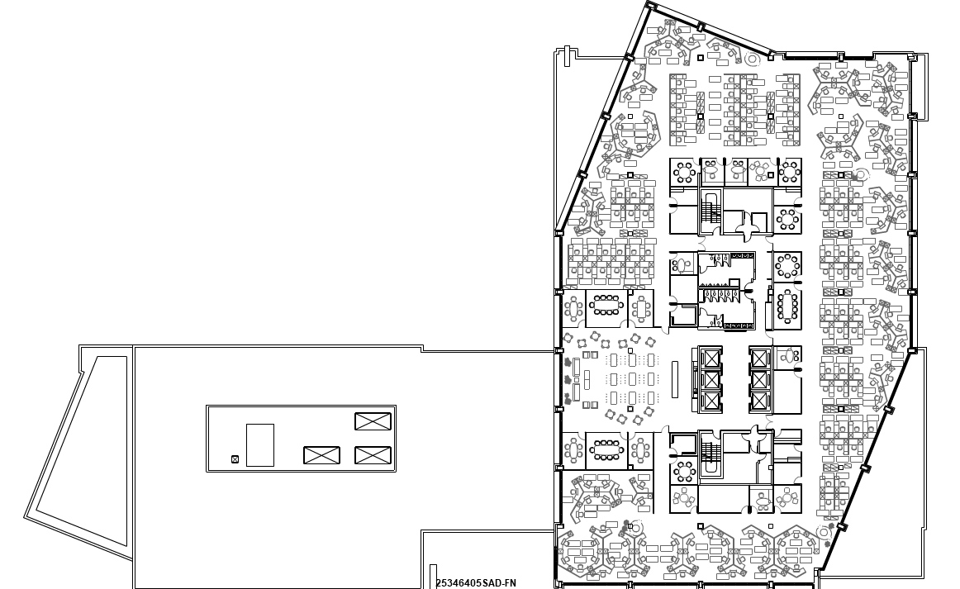
Phase 2 - Floor 5

Slide 21
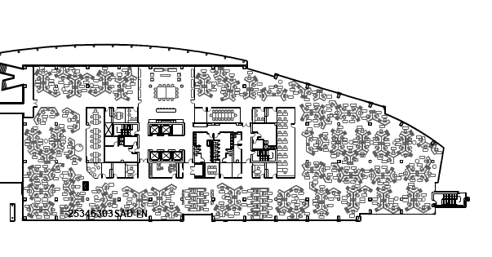
Phase 1 – Building C - floor 3

Slide 22
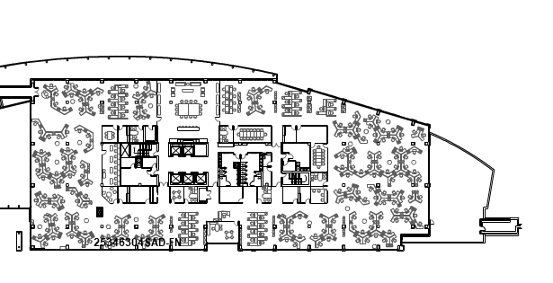
Phase 1 – Building C floor 4

